Slide 1
Module 4 - Two - Dimensional Viewing and Clipping
By Poonam Pangarkar
Department of CSE Data Science Engineering APSIT

Slide 2
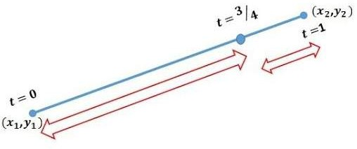
Liang Barsky Clipping Algorithm
Parametric Equation of the line P₁(x₁,y₁) P₂(x₂,y₂)
Consider t: range from 0 to 1
At P₁(x₁,y₁) t=0
At P₂(x₂,y₂) t=1
At ¾ ^{th} of the line : t = ¾
Its location is
x = ¼ x₁ + ¾ x₂ y = ¼ y₁ + ¾ y₂

Slide 3
At time t,
x = (1-t) x₁ + t x₂ y = (1-t) y₁ + t y₂
x = x₁ - t x₁ + t x₂
= x₁ + t (x₂ - x₁)
x = x₁ + tΔx
y = y₁ - t y₁ + t y₂
= y₁ + t (y₂ - y₁)
y = y₁ + tΔy
Parametric Line Equation is
x = x₁ + tΔx y = y₁ + tΔy

Slide 4
As per clipping algorithm, xw_{min} ≤ x ≤ xw_{max}
yw_{min} ≤ y ≤ yw_{max}
Replacing the value of x & y in the above equation xw_{min} ≤ x₁ + tΔx ≤ xw_{max}
yw_{min} ≤ y₁ + tΔy ≤ yw_{max}
x₁ + tΔx ≥ xw_{min} x₁ + tΔx ≤ xw_{max} y₁ + tΔy ≥ yw_{min} y₁ + tΔy ≤ yw_{max}

Slide 5
tΔx ≥ xw_{min} - x₁ ------------------- 1
tΔx ≤ xw_{max} - x₁ ------------------ 2
tΔy ≥ yw_{min} - y₁ ------------------- 3
tΔy ≤ yw_{max} - y₁ ------------------ 4
Multiplying (- sign) to eq^{n} 1 & 3
-tΔx ≤ x₁ - xw_{min} ------------------ 1
tΔx ≤ xw_{max} - x₁ ------------------- 2
-tΔy ≤ y₁ - yw_{min} ------------------- 3
tΔy ≤ yw_{max} - y₁ ------------------- 4
General Equation form tP_{k} ≤ q_{k}
where k=1,2,3,4

Slide 6
P₁ = -Δx P₂ = Δx P₃ = -Δy P₄ = Δy
q1 = x₁ - xw_{min} q2 = xw_{max} - x₁ q3 = y₁ - yw_{min} q4 = yw_{max} - y₁
1 2 3 4 gives information about left, right, bottom and top edges of window

Slide 7
Algorithm
Step 1: Get the endpoints of line as (x ,y ) and (x ,y )
P₁ = -Δx P₂ = Δx P₃ = -Δy P₄ = Δy
q1 = x₁ - xw_{min} q2 = xw_{max} - x₁ q3 = y₁ - yw_{min} q4 = yw_{max} - y₁
1 1 2 2
Step 2: Calculate - Δx, Δy, P_{k}, q_{k}
Step 3: Assign t1=0, t2=1
If P_{k} = 0; Line is parallel
If q_{k} < 0; Line lies outside the window (Reject)
If P_{k} < 0; find t1
t1 = max(0, q_{k}/P_{k}) else P_{k} > 0; find t2
t2 = min(1, q_{k}/P_{k})
If t1 > t2; line is completely outside (rejected) else find new values of x & y from the formula
x = x₁ + tΔx y = y₁ + tΔy

Slide 8
Numericals
1). Window A(20,20) B(90,20) C(90,70) D(20,70); intersecting line M(10,30) N(80,90).
Sol^{n}:
Given :
xw_{min} = 20
xw_{max} = 90
yw_{min} = 20
yw_{max} = 70
M(10,30) | ⇒ x₁= 10 | y₁= 30
N(80,90) | ⇒ x₂= 80 | y₂= 90
Δx = x₂ - x₁ = 80 - 10 = 70 Δy = y₂ - y₁ = 90 - 30 = 60

Slide 9
P₁ = -Δx = -70 P₂ = Δx = 70 P₃ = -Δy = -60 P₄ = Δy = 60
q₁ = x₁ - xw_{min} = 10 - 20 = -10 q₂ = xw_{max} - x₁ = 90 - 10 = 80 q₃ = y₁ - yw_{min} = 30 - 20 = 10 q₄ = yw_{max} - y₁ = 70 - 30 = 40

Slide 10
∵ P_{k} ≠ 0 the line is not parallel to any of the clipping window edges If P_{k} < 0
P₁, P₃
t₁ = max(0, q₁/P₁ , q₃/P₃)
t₁ = max(0, -10/-70 , 10/-60) t₁ = 1/7 = 0.142
If P_{k} > 0
P₂, P₄
t₂ = min(1, q₂/P₂ , q₄/P₄) t₂ = min(1, 80/70 , 40/60) t₂ = ⅔ =0.666

Slide 11
As t₁ < t₂ ; calculate new x, y coordinate For t₁
x = x₁ + tΔx = 10 + 1/7 * 70 = 20
y = y₁ + tΔy = 30 + 1/7 * 60 = 38.57
For t₂
x = x₁ + tΔx = 10 + ⅔ * 70 = 56.67
y = y₁ + tΔy = 30 + ⅔ * 60 = 70
New coordinate of the M’N’ M’ = (20, 38.57) = (20,39)
N’ = (56.67, 70) = (57,70)

Slide 12
Numericals

Slide 13
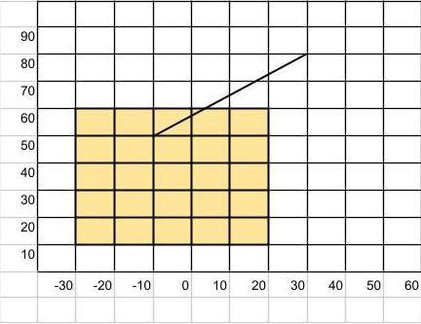
1. Using Liang Barsky Algorithm, find the clipping coordinates of the line segment with end coordinates A(-10, 50) and B(30,80) against the window
(Xmin = -30 and Ymin =10) (Xmax=20 and Ymax=60)
p1 = -40, p2 = 40, p3 =-30, p4 = 30
q1 = 20, q2 = 30, q3 = 40, q4 = 10
t1 = 0, t2 = 0.33
x1’y1’ = (-10,50)
x2’y2’ = (3.2, 59.9)

Slide 14
2. Using Liang Barsky Algorithm, find the clipping coordinates of the line segment with end coordinates A(10,10) and B(70,40) against the window having diagonal vertices (20,20) and (40,50)
p1 = -60, p2 = 60, p3 = 30, p4 = -30
90
80
70
60
50
40
30
20
10
 | -30 | -20 | -10 | 0 | 10 | 20 | 30 | 40 | 50 | 60
q1 = 20, q2 = 30, q3 = 40, q4 = 10
t1 = 0.33, t2 = 0.5
x1’y1’ = (28.98,20)
x2’y2’ = (40, 25)

Slide 15
3. Use Liang Barsky Algorithm for line clipping. Window diagonal vertices are (0,0) and (100,50) and line segment endpoints are A (10,10) and B (110,40)
P1 =-100
P2 = 100
P3 = -30
P4 = 30
Q1 =10
Q2 = 90
Q3 = 10
Q4 = 40
t1 = 0 and t2 = 0.9 10,10
100, 37

Slide 16
4. Use Liang Barsky Algorithm for line clipping. Window diagonal vertices are (1,2) and (9,8) and line segment endpoints are A (11,6) and B (11,10)
P1 =0
P2 =0
q1 = 10
q2 = -2
Pk=0
qk<0 line is outside and parallel to that edge,
qk>0 line is parallel but inside window
qk=0 line is on the edge of the window

Slide 17
5. Use Liang Barsky Algorithm for line clipping. Window diagonal vertices are (1,2) and (9,8) and line segment endpoints are A (6,6) and B (8,9)
p1 = -2, p2 = 2, p3 =-3, p4 = 3
q1 = 5, q2 = 3, q3 = 4, q4 = 2
t1 = 0, t2 = 0.66
x1’y1’ = (6,6)
x2’y2’ = (7.33,8)

Slide 18
6. Explain Liang Barsky line clipping algorithm. Apply the algorithm to the line with the coordinates (30,60) & (60,20) against window (x_{min}, y_{min}) = (10,10) & (x_{max}, y_{max}) = (50,50) (May 2018, 2019 for 10 Marks)
p1=-30, p2=30, p3=40, p4=-40, q1=20, q2=20, q3=50, q4=-10, t1= 0.25, t2=0.67
A’(37.5,50) B’(50,33.2)
7. Explain Liang Barsky line clipping algorithm. Find the coordinates of the line segment A(35,60) B(80,25) after it is clippeed against a window with 2 diagonal vertices at (10,10) & (50,50). December 2018 for 10 Marks)
p1=-45, p2=45, p3=35, p4=-35, q1=25, q2=15, q3=50, q4=-10, t1=0.285, t2=0.33
A’(48,50) B’(50,48)
8. Clip line with coordinates A(5,10) B(35,30) after it is clippeed against a window with 2 diagonal vertices at (10,10) & (20,20). (December 2019 for 5 Marks)
p1= -30, p2= 30, p3= -20, p4= 20, q1= -5, q2= 15, q3= 0, q4= 10, t1= 0.166, t2=
0.5 A’(10, 13.33) B’(20,20)

Slide 19
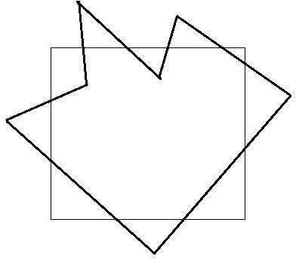
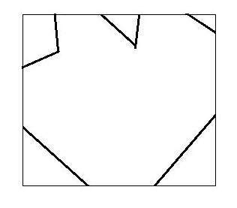
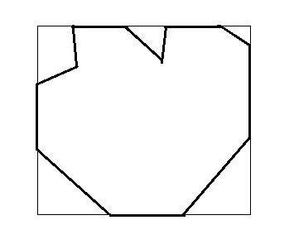
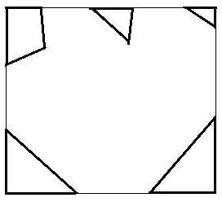
Polygon Clipping Algorithm
(ii)
(i)
(iv)
(iii)

Slide 20
Sutherland-Hodgeman Polygon Clipping Algorithm
Both vertices are inside : Only the second vertex is added to the output list.
First vertex is outside while second one is inside : Both the point of intersection of the edge with the clip boundary and the second vertex are added to the output list.
First vertex is inside while second one is outside : Only the point of intersection of the edge with the clip boundary is added to the output list.
Both vertices are outside : No vertices are added to the output list.

Slide 21
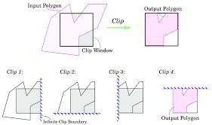

Slide 22
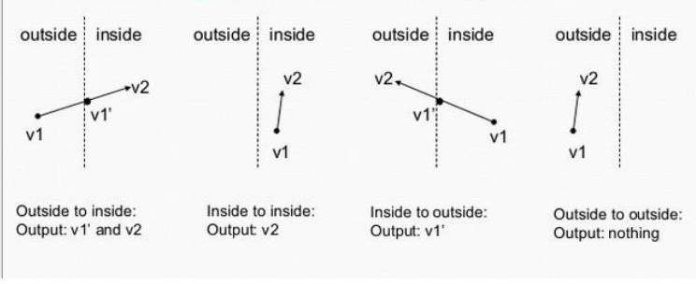

Slide 23
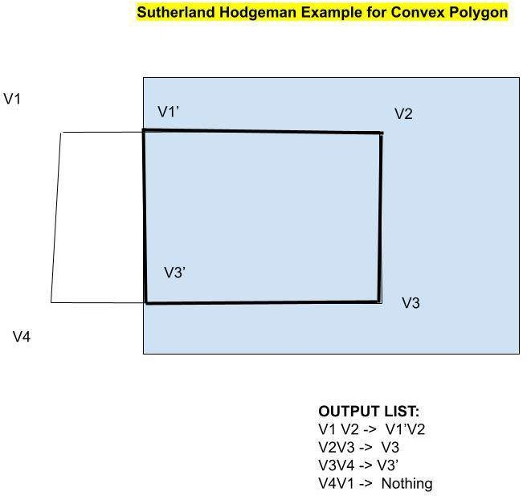

Slide 24
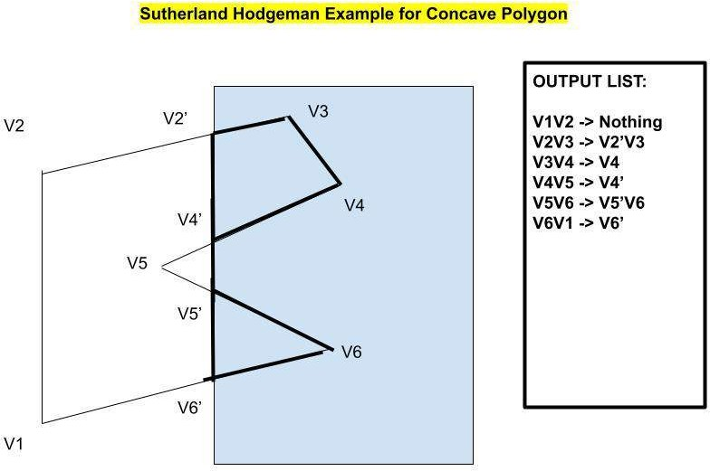

Slide 25
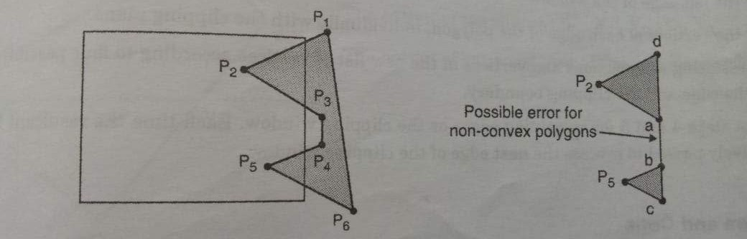
Issue with Sutherland Hodgeman Algorithm

Slide 26
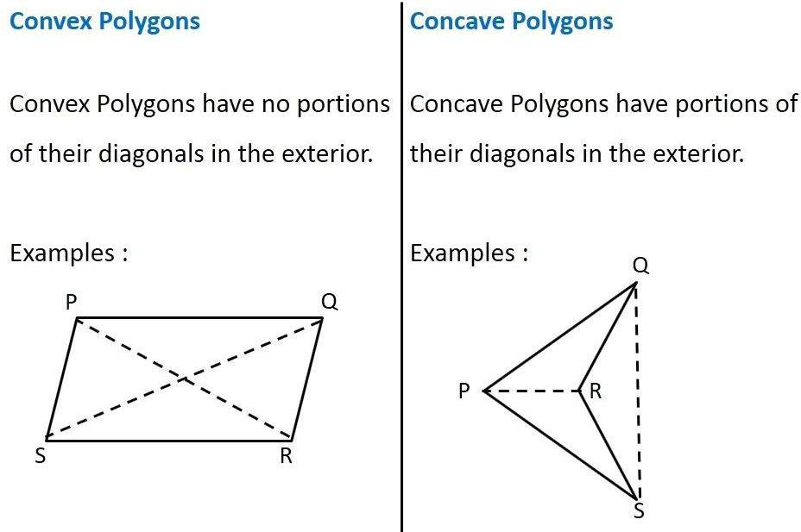
Weiler-Atherton Polygon Clipping Algorithm
Sutherland - Hodgeman polygon clipping clips convex polygon.
There is an inclusion of extraneous lines while clipping concave polygon.

Slide 27
Algorithm
First make a list of all intersection points namely i1, i2, i3, ...
Classify those intersection points as entering or exiting.
Now, make two lists, one for the clipping polygon, and the other for the clipped polygon.
Fill both the lists up in such a way that the intersection points lie between the correct vertices of each of the polygon. That is the clipping polygon list is filled up with all the vertices of the clipping polygon along with the intersecting points lying between the corresponding vertices.
Now, start at the 'to be clipped' polygon's list.
Choose the first intersection point which has been labelled as an entering point. Follow the points in the list (looping back to the top of the list, in case the list ends) and keep on pushing them into a vector or something similar of the sorts. Keep on following the list until an exiting intersection point is found.
Now switch the list to the 'polygon that is clipping' list, and find the exiting the intersection that was previously encountered. Now keep on following the points in this list (similar to how we followed the previous list) until the entering intersection point is found (the one that was found in the previous 'to be clipped' polygon's list).
This vector now formed by pushing all the encountered points in the two lists, is now the clipped polygon (one of the many clipped polygons if any of the clipping polygons is concave).
Repeat this clipping procedure (i.e. from step 5) until all the entering intersection points have been visited once.

Slide 28
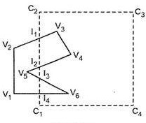
Subject
Clip
V1
C1
V2
I4
I1 (START)
I3
V3
I2
V4
I1
Entering List: I1, I3
Leaving List: I2, I4
Output List:
For I1 -> I1, V3, V4, I2, I1 For I3 -> I3, V6, I4, I3
I2
C2
V5
C3
I3 (START)
C4
V6
I4

Slide 29
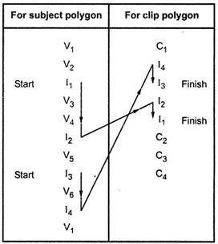
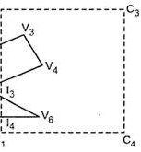
C₂
I₁ I₂
C₁

Slide 30
References
K. Weiler and P. Atherton. 1988. Hidden surface removal using polygon area sorting. In Tutorial: computer graphics; image synthesis, Kenneth I. Joy, Charles W. Grant, Nelson L. Max, and Lansing Hatfield (Eds.). Computer Science Press, Inc., New York, NY, USA 209-217
Hearn & Baker, “Computer Graphics C version”, 2nd Edition, Pearson Publication

